Slide 1
1.2 Displaying Distributions with Graphs
Graphs for categorical variables
Bar graphs
Pie charts
Graphs for quantitative variables
Histograms
Stemplots

Slide 2
Variables
We construct a set of data by first deciding which cases or units we want to study. For each case, we record information about characteristics that we call variables.
Individual
An object described by data
Categorical variable
Places individual into one of several groups or categories
Variable
Characteristic of the individual
Quantitative variable
Takes numerical values for which arithmetic operations make sense

Slide 3
Distribution of a Variable
To examine a single variable, we graphically display its distribution.
The distribution of a variable tells us what values it takes and how often it takes these values.
Distributions can be displayed using a variety of graphical tools. The proper choice of graph depends on the nature of the variable.
Categorical variable
Pie chart
Bar graph
Quantitative variable
Histogram
Stemplot

Slide 4
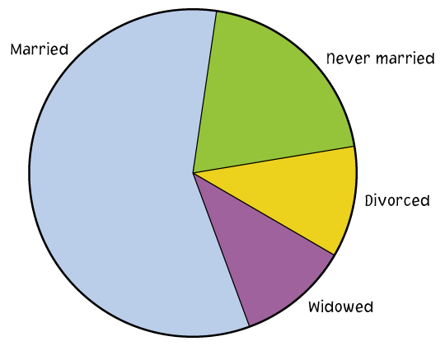
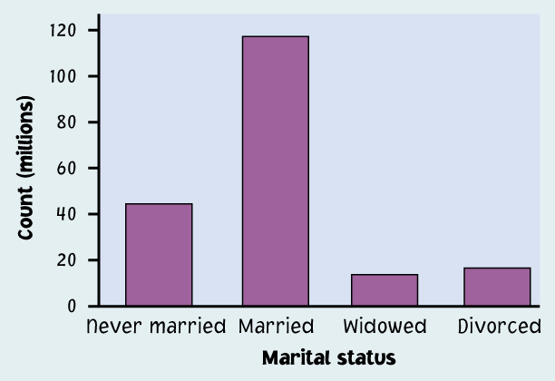
Categorical Variables
The distribution of a categorical variable lists the categories and gives the count or percent of individuals who fall into each category.
Pie charts show the distribution of a categorical variable as a “pie” whose slices are sized by the counts or percents for the categories.
Bar graphs represent categories as bars whose heights show the category counts or percents.

Slide 5
Categorical Variables
Example: Class rank in a statistics course

Slide 6
Categorical Variables
Example: Number of children in family

Slide 7
How to draw Bar Chart and Pie Chart
Excel commands:
--Select data
--click the little icon at the right
lower corner
--choose charts
--more charts
--pie chart
(or clustered column for “bar chart”)

Slide 8
Quantitative Variables
The distribution of a quantitative variable tells us what values the variable takes on and how often it takes those values.
Stemplots separate each observation into a stem and a leaf that are then plotted to display the distribution while maintaining the original values of the variable.
Histograms show the distribution of a quantitative variable by using bars. The height of a bar represents the number of individuals whose values fall within the corresponding class.

Slide 9
Stemplots
To construct a stemplot:
Separate each observation into a stem (all but the rightmost digit) and a leaf (the remaining digit).
Write the stems in a vertical column; draw a vertical line to the right of the stems.
Write each leaf in the row to the right of its stem; order leaves if desired.

Slide 10
Stemplots
Example data: 58 48 80 50 91 78 77 72 80 60
83 54 83 65 57 66 52 66 51 67
85 74 66 44 70 53 62 81 56 89
70 86 45 44 75 68 67 72 87 48
45 59 80 80 32 63 73 39 66 60

Slide 11
Display numeric data---Stem and leaves

Slide 12
Stemplots
Example: Weight Data ― Introductory Statistics Class
10 0166
11 009
12 0034578
13 00359
14 08
15 00257
16 555
17 000255
18 000055567
19 245
20 3
21 025
22 0
23
24
25
26 0
5
2
2
Key
20|3 means 203 pounds
Stems = 10s Leaves = 1s
Stems
Leaves

Slide 13
Stemplot
Draw stemplot for the data points below.
24 36 38 31 40 50 31 30 30 28 35 30

Slide 14
Histograms
For large datasets and/or quantitative variables that take many values:
Divide the possible values into classes or intervals of equal widths.
Count how many observations fall into each interval. Instead of counts, one may also use percents.
Draw a picture representing the distribution―each bar height is equal to the number (or percent) of observations in its interval.

Slide 15
Histograms
Example: IQ Scores – 60 5th graders

Slide 16
Histograms

Slide 17
How to use pivot table to group data and get bar chart
Select the data→ insert→ pivot chart and pivot table → fill in the input and output range→ ok → click the variable you want to draw bar chart → drag the variable to the field “values”.

Slide 18
Use Excel to get histogram
Select data
Insert
Statistic chart
Histogram chart
Right click any bar of the histogram
Format data series
Series option
Horizontal category axis.
Choose bin number you want.

Slide 19
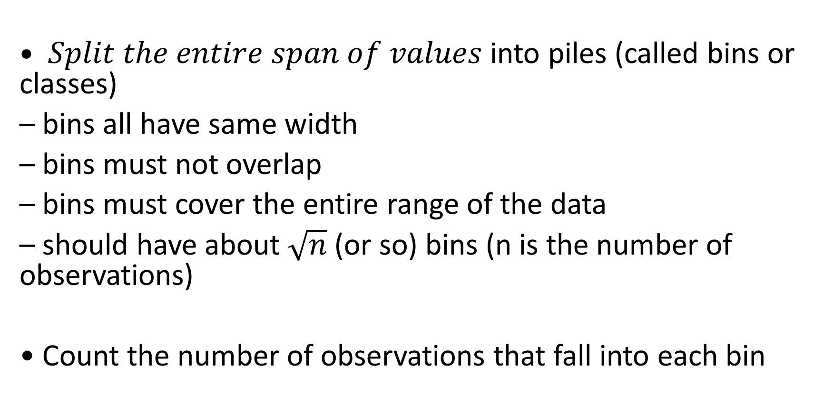
How to decide the number of bins in histogram
$• Split the entire span of values$into piles (called bins or classes)
– bins all have same width
– bins must not overlap
– bins must cover the entire range of the data
– should have about $\sqrt{n}$ (or so) bins (n is the number of observations)
• Count the number of observations that fall into each bin

